Slide 1


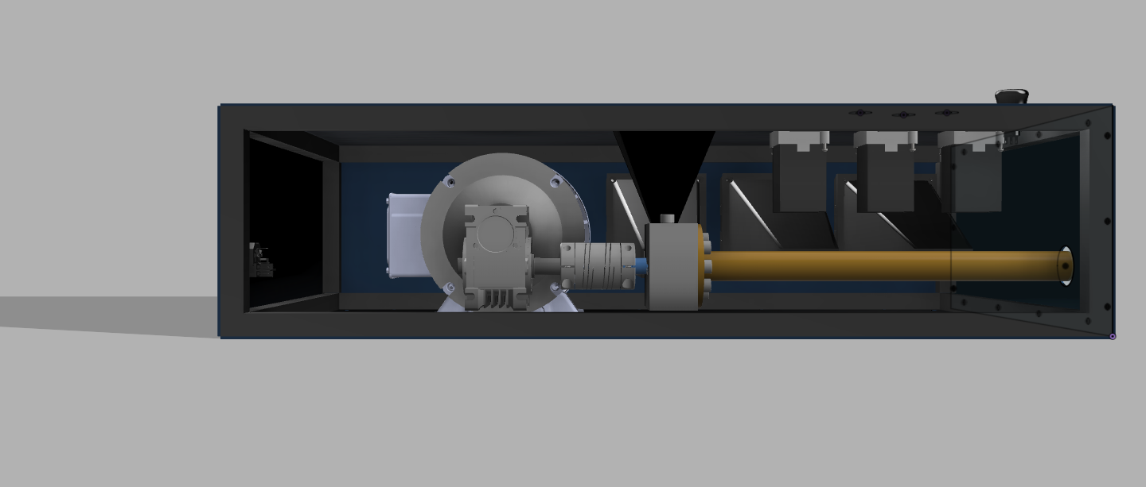
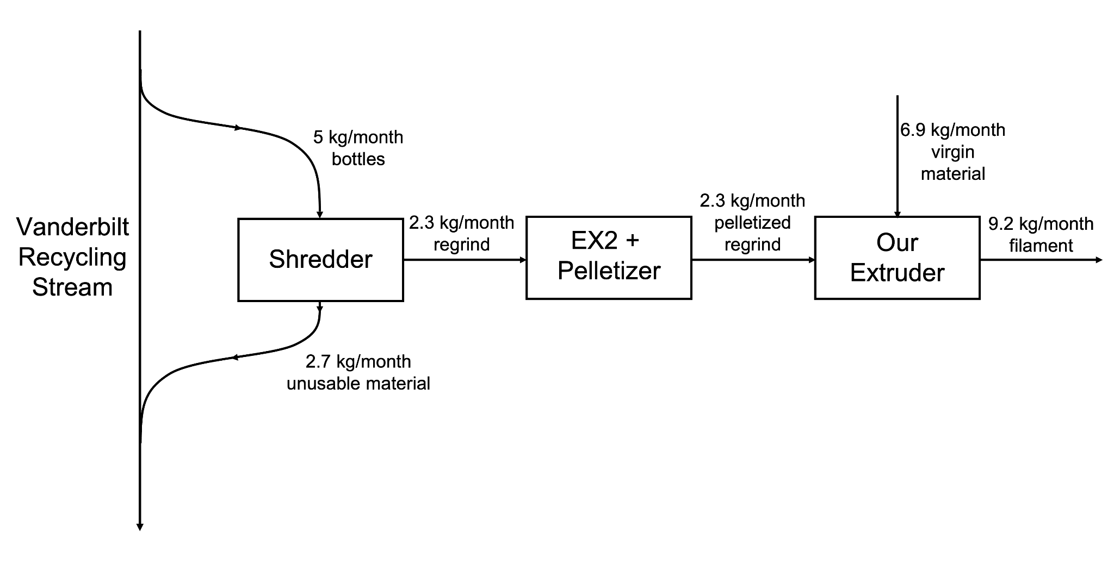
Recycled Polyethylene Terephthalate Filament Extruder
ChBE 01: Melanie Marszal, Amy Pang, Blake Christiansen, Sam Leville
Introduction & Background
CAD & Assembly
Process Economics
As sustainability grows increasingly important in our world, the Little Engineers That Could set out to create a circular plastics economy on Vanderbilt campus. We designed, modeled, and assembled an extruder ourselves that is capable of turning polyethylene terephthalate (PET) bottles from students into 3D printing filament for makerspaces across campus.
CAD
Before assembling our extruder, we created a full 3D model of it using Fusion 360. All parts were original models, imported from McMaster-Carr, or imported from GrabCAD.
Assembly
We obtained most of the parts for our extruder from McMaster-Carr and Amazon. We were able to 3D print smaller components. Specialty parts with custom measurements to our extruder were machined by us or machined by a machine shop. By physically building our own extruder, we were able to perfect our prototype through multiple iterations of design.
Capital Investment
The Total Capital Investment, which is the sum the capital contributions to build and run the extruder, is $5,433.38.
Table 2. Key Costs and Revenue Sources
Cost/Revenue Source | Value | Cost/Revenue Source | Value
PETG Filament | $31.50 / kg | Storage Cost | $268.00 / 6 months
rPETG Pellets | $56.27 / 5 kg | Electricity | $0.1065 / kWh
Labor | $10.00 / hr / person | Amazon Fulfillment | $4.94 / kg
Product Shipping | $250.00 / 100 kg | Amazon Referral | 12% of revenue
Process Flow Diagram
Figure 2. Fusion 360 Rendering of Assembled Extruder
“Commercial” vs “As Needed” Approach
The “Commercial” approach assumes there is demand for filament that matches our maximum production rate. The profit for our extruder in this case is $5,000/year, resulting in a payback period of just over a year. If the cost of the extruder is considered a loan, it would take us 3 years and 7 months to payback our loan.
The “As Needed” approach assumes that our production rate matches the demand produced by the Digital Fabrication lab (~ 30 kg/year). Our extruder would save $776 per year.
Figure 1. Process Flow Diagram
Equipment & Sizing
Barrel Wall Thickness
The barrel wall must be a certain thickness in order to withstand the maximum simulated pressure experienced.
We found that with a barrel thickness of 0.479 in, a pressure of 865 psi, and an outer diameter of 1.109 in the allowable stress is 1001 psi. The barrel is made from 12L14 steel which has a yield strength of 60,000 psi meaning our safety factor is around 60.
Motor rating
According to simulation, the screw need around ¼ hp in order to extrude. We oversized the motor and purchased a ⅓ hp motor since this will be more capable in more situations.
Heaters
The heaters needed to be rated for the melting temperature of rPET (250 °C), and the rectangular cross-section of the cylindrical heaters need to match to surface area of the barrel.
Safety
The regrind-making process and assembly of the extruder highlighted health and safety concerns. We conducted a Hazard and Operability Analysis (HAZOP) and a Failure Mode and Effects Analysis (FMEA). From these analyses, the greatest hazards are summarized as follows:
Conclusion & Recommendations
The result of our project is a successfully built rPET extruder prototype. The extruder is designed to run 25% recycled PET pellets and 75% virgin PETG pellets. For future groups working on this project we recommend optimizing the barrel for higher throughput and integrating more process control mechanisms.
Table 1. Summary of Process Hazards
Hazard | Safeguard/Recommendation
High Barrel Pressure | Shear plate to absorb force, emergency stop button
Rotating Machinery | Hopper lid to cover opening, proper PPE
High Temperatures | PID controllers programmed to conservative setpoint values, emergency stop button
Acknowledgements
We would like toVU Plant Operations, VU Immersion, VU Chemical Engineering Department, Dr. Guelcher, Dr. Florian, and Skyler Hornback.

